Slide 1
Introduction to CUDA compiled by Dr. N. Gopalakrishna Kini Prof., Dept of CSE MIT, Manipal

Slide 2
INTRODUCTION
Computing system consists of a host, CPU, and one or more devices, which are massively parallel processors equipped with a large number of arithmetic execution units.
The Compute Unified Device Architecture (CUDA) devices accelerate the execution of these applications by harvesting a large amount of data parallelism.
Data parallelism plays such an important role in CUDA.

Slide 3
CUDA PROGRAM STRUCTURE
A CUDA program consists of one or more phases that are executed on either the host (CPU) or a device such as a GPU.
The phases that exhibit little or no data parallelism are implemented in host code.
The phases that exhibit rich amount of data parallelism are implemented in the device code.
A CUDA program is a unified source code encompassing both host and device code.
The NVIDIA C compiler (nvcc) separates the two during the compilation process.
The host code is straight ANSI C code; it is further compiled with the host’s standard C compilers and runs as an ordinary CPU.

Slide 4
The device code is written using ANSI C extended with keywords for labeling data-parallel functions, called kernels, and their associated data structures.
The device code is compiled by the nvcc and executed on a GPU device.
In situations where no device is available , one can also choose to execute kernels on a CPU using the emulation features in CUDA software development kit (SDK) or the MCUDA tool.
The kernel functions (or, simply kernels) typically generate a large number of threads to exploit data parallelism.

Slide 5
In the mat mul eg, the entire matrix multiplication computation can be implemented as a kernel where each thread is used to compute one element of output matrix.
CUDA threads are of much lighter weight than the CPU threads.
Due to efficient hardware support, CUDA programmers finds that these threads take very few cycles to generate and schedule.
This is in contrast with the CPU threads that typically require thousands of clock cycles.

Slide 6
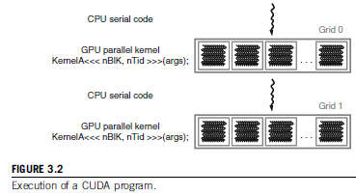
The execution starts with host (CPU) execution.
When a kernel function is invoked, the execution is moved to a device (GPU), where a large number of threads are generated to take advantage of rich data parallelism.
All the threads that are generated by a kernel during an invocation are collectively called a grid.
When all threads of a kernel complete their execution, the corresponding grid terminates, and the execution continues on the host until another kernel is invoked.

Slide 7
As in OpenCL
CPU is the host & its memory is the host memory
GPU is the device & its memory is device memory.
Serial code will be run on host & llel code will on device.
1. Copy data from host memory to device memory.
2. Load device program and execute, caching data on chip for performance.
3. Copy result from device memory to host memory.

Slide 8
#include "cuda_runtime.h"
#include "device_launch_parameters.h"
_ _global_ _ void add(int *a, int *b, int *c)
{
*c = *a + *b;
}
int main(void)
{
int a, b, c; // host copies of variables a, b & c
int *d_a, *d_b, *d_c; // device copies of variables a, b & c
int size = sizeof(int);

Slide 9
// Allocate space for device copies of a, b, c
cudaMalloc((void **)&d_a, size);
cudaMalloc((void **)&d_b, size);
cudaMalloc((void **)&d_c, size);
// Setup input values
a = 3;
b = 5;
// Copy inputs to device
cudaMemcpy(d_a, &a, size, cudaMemcpyHostToDevice);
cudaMemcpy(d_b, &b, size, cudaMemcpyHostToDevice);
// Launch add() kernel on GPU
add<<<1,1>>>(d_a, d_b, d_c);

Slide 10
// Copy result back to host
cudaMemcpy(&c, d_c, size, cudaMemcpyDeviceToHost);
// Cleanup
cudaFree(d_a);
cudaFree(d_b);
cudaFree(d_c);
return 0;
}

Slide 11
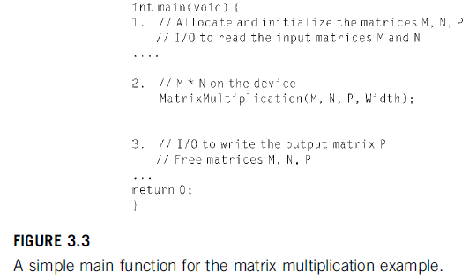
A MATRIX–MATRIX MULTIPLICATION EXAMPLE
To illustrate the CUDA program structure, first consider a simple main function skeleton for the matrix multiplication.
In the pgm first it allocates M, N, and P matrices in the host memory.
Then it performs I/O read in M and N.
Part 3 performs I/O to write the product matrix P and to free all the allocated matrices.
Part 2 is the main focus of our interest.

Slide 12
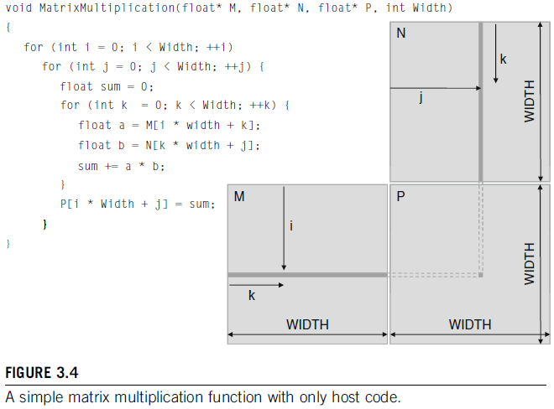
A MATRIX–MATRIX MULTIPLICATION EXAMPLE (Contd..)
In PART 2 call to a function, MatrixMultiplication(), to perform mat mul on a device.
Before to know how to use a CUDA device to execute the mat mul fn, let us see a conventional CPU-only matrix multiplication function.

Slide 13
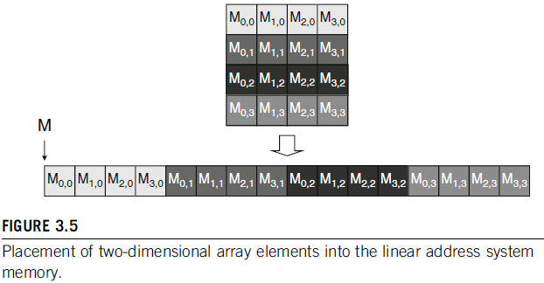
A MATRIX–MATRIX MULTIPLICATION EXAMPLE (Contd..)
The MatrixMultiplication() fn impl a straightforward algo consisting of 3 loop levels.
Innermost loop iterates over variable k and steps through one row of matrix M and one column of matrix N.
This loop calc a dot product of the row of M and the column of N to generate one element of P.
The index used for accessing the M matrix in the innermost loop is
(i*Width+k).
M matrix elements are placed into this linear addressed memory is done according to the row-major convention, as below:

Slide 14
A MATRIX–MATRIX MULTIPLICATION EXAMPLE (Contd..)
In Fig., Part 1 of the function allocates device (GPU) memory to hold
copies of the M, N, and P matrices and copies these matrices over to the
device memory.
Part 2 invokes a kernel that launches parallel execution of the actual matrix multiplication on the device.
Part 3 copies the product matrix P from the device memory back to the host memory.

Slide 15
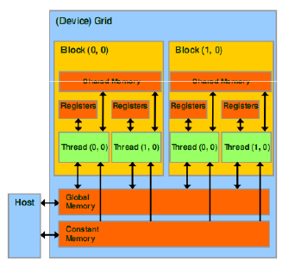
DEVICE MEMORIES AND DATA TRANSFER (Contd..)
Global memory and constant memory are the memories that the host code can transfer data to and from the device, as illustrated by the bidirectional arrows b/n these memories and the host.
Constant memory allows read-only access by the device code.

Slide 16
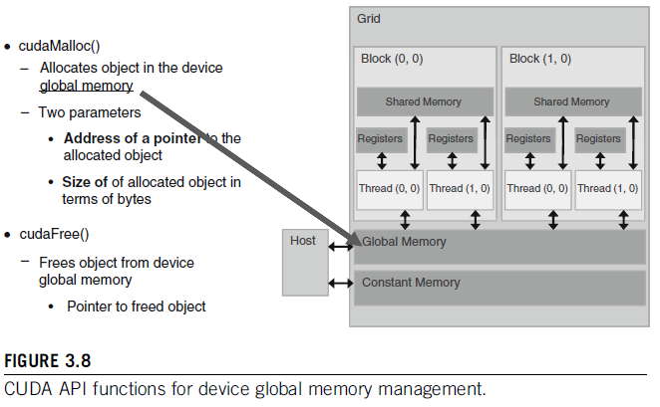
DEVICE MEMORIES AND DATA TRANSFER (Contd..)
Fig. shows the API functions for allocating and deallocating device global memory.
cudaMalloc ((void **)&d_a, size);
cudaFree(d_a);

Slide 17
DEVICE MEMORIES AND DATA TRANSFER (Contd..)
The function cudaMalloc() can be called from the host code to allocate global memory for an object.
Striking IIIty b/n cudaMalloc() and the standard C runtime library malloc().
This is intentional. CUDA uses the standard C runtime library malloc() function to manage the host memory and adds cudaMalloc() as an extension to the C runtime library.

Slide 18
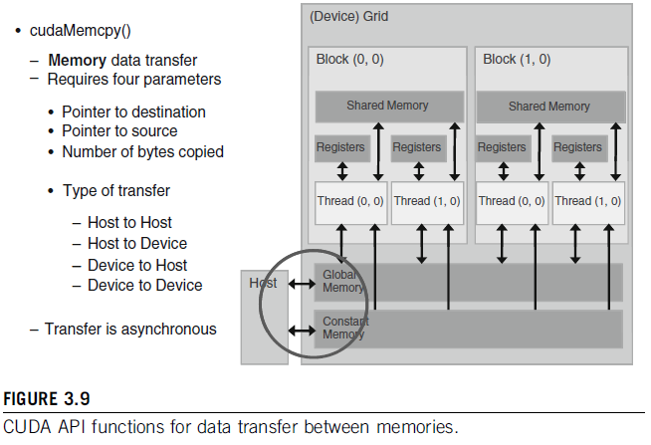
DEVICE MEMORIES AND DATA TRANSFER (Contd..)
Once a program has allocated device global memory for the data
objects, it can request that data be transferred from host to device.
This is accomplished by cudaMemcpy()
cudaMemcpy (d_a, &a, size, cudaMemcpyHostToDevice);

Slide 19
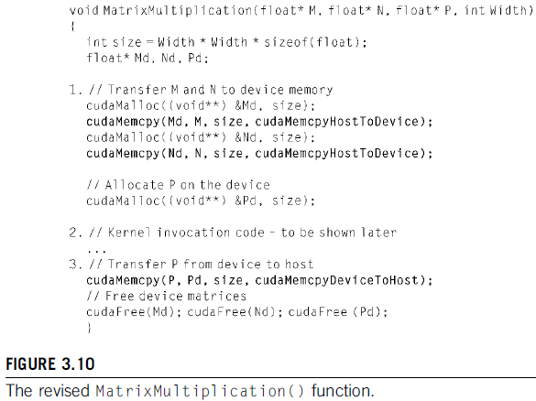
DEVICE MEMORIES AND DATA TRANSFER (Contd..)
Note that cudaMemcpyHostToDevice and cudaMemcpyDeviceToHost, are predefined constants of the CUDA programming environment.
The same API can be used to transfer data in both directions by properly ordering the source and destination pointers.

Slide 20
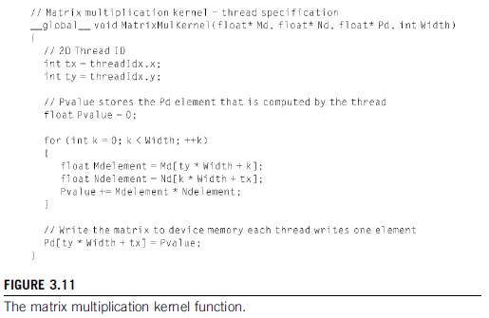
KERNEL FUNCTIONS AND THREADING
A kernel function specifies the code to be executed by all threads during a parallel phase.
Because all of these threads execute the same code, CUDA programming is an instance of single-program, multiple-data (SPMD) parallel programming.
The kernel function for matrix multiplication.

Slide 21
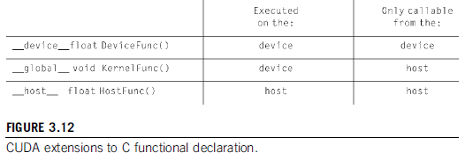
KERNEL FUNCTIONS AND THREADING (Contd..)
First, there is a CUDA-specific keyword “_ _global_ _” in front of the declaration of MatrixMulKernel().
-This keyword indicates that the function is a kernel
-it can be called from a host functions to generate a grid of threads on a device.
Besides _ _global_ _, there are two other keywords which can be used in front of a function declaration.

Slide 22
KERNEL FUNCTIONS AND THREADING (Contd..)
The _ _device_ _ keyword indicates that
-the function being declared is a CUDA device function.
-A device function executes on a CUDA device and can only be called from a kernel function.
The _ _host_ _keyword indicates that
-the function being declared is a CUDA host function.
-A host function is simply a traditional C function that executes on the host and can only be called from another host function.
If the functions do not have any of the CUDA keywords in their declaration, they will become host functions in a CUDA program.

Slide 23
KERNEL FUNCTIONS AND THREADING (Contd..)
Other keywords are
threadIdx.x and threadIdx.y
which refer to the thread indices of a thread.
All threads execute the same kernel code.
There needs a mechanism to allow threads to distinguish themselves and direct themselves toward the required part of the data structure that they are designated to work on.
These keywords identify predefined variables that allow a thread to access the data at runtime by identifying coordinates to the thread.
Different threads will see different values in their threadIdx.x and threadIdx.y variables.

Slide 24
KERNEL FUNCTIONS AND THREADING (Contd..)
Note that the coordinates x and y reflect a multidimensional organization for the threads.
Kernel function has only one loop, which corresponds to the innermost loop k.
Where the other two levels of outer loops go?
The answer is that the outer two loop levels are now replaced with the grid of threads.
The entire grid forms the equivalent of the two-level loop.
Each thread in the grid corresponds to one of the iterations of the outer two loops.
The loop variables i and j are now replaced with threadIdx.x and threadIdx.y.
Instead of having the loop increment the values of i and j, the CUDA threading hardware generates all of the threadIdx.x and threadIdx.y values for each thread.
In our kernel pgm, each thread uses its threadIdx.x and threadIdx.y to identify the row of Md and the col of Nd to perform the dot product.

Slide 25
KERNEL FUNCTIONS AND THREADING (Contd..)
Here, we assigned threadIdx.x to the variable tx and threadIdx.y to variable ty.
Each thread uses its threadIdx.x and threadIdx.y values to select the Pd element that it is responsible for.
For eg, Thread_{2,3} will perform a dot product between column 2 of Nd and row 3 of Md and write the result into element (3, 2) of Pd.
This way, the threads collectively generate all the elements of the Pd matrix.
When a kernel is invoked, or launched, it is executed as grid of parallel threads.

Slide 26
KERNEL FUNCTIONS AND THREADING (Contd..)
In Fig., the launch of Kernel 1 creates Grid 1.
Each CUDA thread grid typically is comprised of thousands to millions of lightweight GPU threads per kernel invocation.
Each element of a large array might be computed in a separate thread.
Threads in a grid are organized into a two-level hierarchy, as in Fig.
At the top level, each grid consists of one or more thread blocks.
All blocks in a grid have the same number of threads.
In Fig., Grid 1 is organized as a 2 x 2 array of 4 blocks.
Each block has a unique two-dimensional coordinate given by the CUDA specific keywords blockIdx.x and blockIdx.y.

Slide 27
KERNEL FUNCTIONS AND THREADING (Contd..)
Each thread block is, in turn, organized as a three-dimensional array of threads with a total size of up to 512 threads.
The coordinates of threads in a block are uniquely defined by three thread indices: threadIdx.x, threadIdx.y, and threadIdx.z.
Not all applications will use all three dimensions of a thread block. In Figure 3.13, each thread block is organized into a 4 x 2 x 2 three-dimensional array of threads. This gives Grid 1 a total of 4 x 16 = 64 threads.

Slide 28
KERNEL FUNCTIONS AND THREADING (Contd..)
In our matrix multiplication example, a grid is invoked to compute the product matrix.
The code does not use any block index in accessing input and output data.
Threads with the same threadIdx values from different blocks would end up accessing the same input and output data elements.
As a result, the kernel can use only one thread block.
The threadIdx.x and threadIdx.y values are used to organize the block into a two-dimensional array of threads.
Because a thread block can have only up to 512 threads, and each thread calculates one element of the product matrix, the code can only calculate a product matrix of up to 512 elements.
As we explained before, the product matrix must have millions of elements in order to have a sufficient amount of data parallelism to benefit from execution on a device.

Slide 29
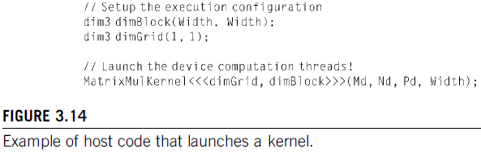
KERNEL FUNCTIONS AND THREADING (Contd..)
When the host code invokes a kernel, it sets the grid and thread block
dimensions via execution configuration parameters.
This is illustrated above. Two struct variables of type dim3 are declared. The first is for describing the configuration of blocks.
-which are defined as 16 x 16 groups of threads.
The second variable, dimGrid, describes the configuration of the grid.
-In this example only one (1 x 1) block in grid.
The final line of code invokes the kernel.
It provides the dimensions of the grid in terms of number of blocks and the dimensions of the blocks in terms of number of threads.

Slide 30
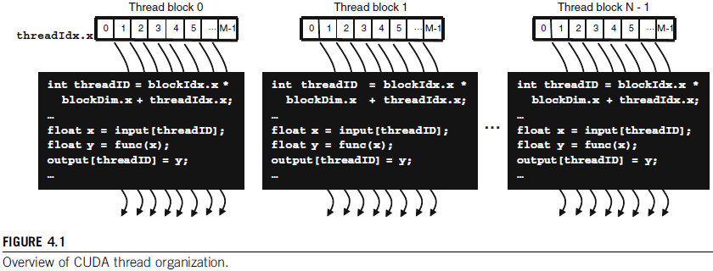
CUDA THREAD ORGANIZATION (Contd..)
Fig. is a simple example of CUDA thread organization.
The grid consists of N blocks, each with a blockIdx.x value that ranges from 0 to N – 1.
Each block, further, consists of M threads, each thread with a threadIdx.x value that ranges from 0 to M – 1.

Slide 31
CUDA THREAD ORGANIZATION (Contd..)
All blocks at the grid level are organized as a one-dimensional (1D) array. All threads within each block are also organized as a 1D array.
A grid has a total of N*M threads.
A thread in the kernel code shown uses
threadID = blockIdx.x * blockDim.x + threadIdx.x
to identify the part of the input data to read from and the part of the output data to write to.
Thread 3 of Block 0 has a threadID value of 0*M + 3 = 3.
Thread 3 of Block 5 has a threadID value of 5*M + 3.

Slide 32
CUDA THREAD ORGANIZATION (Contd..)
Assume a grid has 128 blocks (N = 128) and each block has 32 threads
(M = 32).
Here, access to gridDim in the kernel returns 128. (dim3 gridDim(size))
Here, access to blockDim in the kernel returns 32. (dim3 blockDim(size))
There are a total of 128*32 = 4096 threads in the grid.
Thread 3 of Block 0 has a threadID value of 0*32 + 3 = 3.
Thread 3 of Block 5 has a threadID value of 5*32 + 3 = 163.
Thread 15 of Block 102 has a threadID value of 102*32 +15 =3279.
Note that each one of the 4096 threads has its own unique threaded value.

Slide 33
CUDA THREAD ORGANIZATION (Contd..)
If we assume both arrays are declared with 4096 elements, then each thread will take one of the input elements and produce one of the output elements.
--------------------------------
In general, a grid is organized as a 2D array of blocks.
Each block is organized into a 3D array of threads.
The exact organization of a grid is det by the execution configuration provided at kernel launch.
The first parameter of the exec config specifies the dimensions of the grid in terms of number of blocks.
The second specifies the dimensions of each block in terms of number of threads.
Each such parameter is a dim3 type, which is essentially a C struct with three unsigned integer fields: x, y, and z.
As grids are 2D arrays of block dimensions, the third field of the grid dimension is ignored; it should be set to 1 for clarity.

Slide 34
CUDA THREAD ORGANIZATION (Contd..)
The following host code can be used to launch the kernel whose organization is shown below:
dim3 dimGrid(128, 1, 1);
dim3 dimBlock(32, 1, 1);
KernelFunction<<<dimGrid, dimBlock>>>(. . .);
Because the grid and the blocks are 1D arrays, only the first dimension
of dimBlock and dimGrid are used. The other dimensions are set to 1.
The third statement is the actual kernel launch. The exec config parameters are between <<< and >>>.

Slide 35
CUDA THREAD ORGANIZATION (Contd..)
Note that scalar values can also be used for the exec config parameters if a grid or block has only one dimension;
Eg., the same grid can be launched with one statement:
KernelFunction<<<128, 32>>>(. . .);
The values of gridDim.x and gridDim.y can range from 1 to 65,535.
Once a kernel is launched, its dimensions cannot change. All threads in a block share the same blockIdx value.
The blockIdx.x value ranges between 0 and gridDim.x - 1, and the
blockIdx.y value between 0 and gridDim.y - 1.

Slide 36
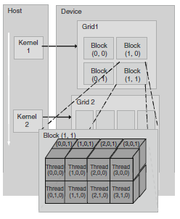
CUDA THREAD ORGANIZATION (Contd..)
Fig. shows a small 2D grid that is launched with the following
host code:
dim3 dimGrid(2, 2, 1);
dim3 dimBlock(4, 2, 2);
KernelFunction<<<dimGrid, dimBlock>>>(. . .);
The grid consists of four blocks organized into a 2 X 2 array.
Each block is labeled with (blockIdx.x, blockIdx.y); for example,
Block(1,0) has blockIdx.x = 1 and blockIdx.y = 0.

Slide 37
CUDA THREAD ORGANIZATION (Contd..)
In general, 2 D blocks are organized into 3D arrays of threads.
All blocks in a grid have the same dimensions.
Each threadIdx consists of three components:
the x coordinate threadIdx.x, threadIdx.y, and threadIdx.z.
The total size of a block is limited to 512 threads,
with flexibility in distributing these elements into the three dimensions.
Eg. (512, 1, 1), (8, 16, 2), and (16, 16, 2) are all allowable blockDim values, but (32, 32, 1) is not allowable because the total number of threads would be 1024.

Slide 38
1-D grid and/or 1-D blocks
For 1-D structure, one can use an integer for each of B and T in:
myKernel<<< B, T >>>(arg1, … );
B – An integer would define a 1D grid of that size
T –An integer would define a 1D block of that size
myKernel<<< 1, 100 >>>(arg1, … );
Grids can be 2D and blocks can be 2D or 3D

Slide 39
Compute global 1-D thread ID
dim3
threadIdx.x -- “thread index” within block in “x” dimension
blockIdx.x -- “block index” within grid in “x” dimension
blockDim.x -- “block dimension” in “x” dimension (i.e. number of threads in a block in the x dimension)
Full global thread ID in x dimension can be computed by:
x = blockIdx.x * blockDim.x + threadIdx.x;

Slide 40
Some of the calculations for indexing the thread is given below.
1D grid of 1D blocks:
__device__int getGlobalID_1D_1D(){
return blockIdx.x *blockDim.x + threadIdx.x;
}
1D grid of 2D blocks
__device__int getGlobalID_1D_2D(){
return blockIdx.x * blockDim.x * blockDim.y
+ threadIdx.y * blockDim.x + threadIdx.x;
}
1D grid of 3D blocks
__device__int getGlobalID_1D_3D(){
return blockIdx.x * blockDim.x * blockDim.y * blockDim.z
+ threadIdx.z * blockDim.y * blockDim.x
+ threadIdx.y * blockDim.x + threadIdx.x;
}

Slide 41
2D grid of 1D blocks
__device__ int getGlobalID_2D_1D(){
int blockId = blockIdx.y * gridDim.x + blockIdx.x;
int threadId = blockId * blockDim.x + threadIdx.x;
return threadId;
}
2D grid of 2D blocks
__device__int getGlobalID_2D_2D(){
int blockId = blockIdx.x + blockIdx.y * gridDim.x;
int threadId = blockId * (blockDim.x * blockDim.y)
+ (threadIdx.y * blockDim.x) + threadIdx.x;
return threadId;
}
2D grid of 3D blocks
__device__int getGlobalID_2D_3D(){
int blockId = blockIdx.x + blockIdx.y * gridDim.x;
int threadId = blockId * (blockDim.x * blockDim.y * blockDim.z)
+ (threadIdx.z * (blockDim.x * blockDim.y))
+ (threadIdx.y * blockDim.x) + threadIdx.x;
return threadId;
}

Slide 42
3D grid of 1D blocks
__device__int getGlobalID_3D_1D(){
int blockId = blockIdx.x + blockIdx.y * gridDim.x
+ gridDim.x * gridDim.y * blockIdx.z;
int threadId = blockId * blockDim.x + threadIdx.x;
return threadId;
}
3D grid of 2D blocks
__device__int getGlobalID_3D_2D(){
int blockId = blockIdx.x + blockIdx.y * gridDim.x
+ gridDim.x * gridDim.y * blockIdx.z;
int threadId = blockId * (blockDim.x * blockDim.y)
+ (threadIdx.y * blockDim.x) + threadIdx.x;
return threadId;
}
3D grid of 3D blocks
__device__int getGlobalID_3D_3D(){
int blockId = blockIdx.x + blockIdx.y * gridDim.x
+ gridDim.x * gridDim.y * blockIdx.z;
int threadId = blockId * (blockDim.x * blockDim.y * blockDim.z)
+ (threadIdx.z * (blockDim.x * blockDim.y))
+ (threadIdx.y * blockDim.x) + threadIdx.x;
return threadId;
}

Slide 43
//Capture the time of execution of kernel
#include <cuda.h>
#include <stdlib.h>
#define N 4096 // size of array
int main(int argc, char *argv[])
{
cudaEvent_t start, stop; // using cuda events to measure time
float elapsed_time_ms;
cudaEventCreate( &start );
cudaEventCreate( &stop );
cudaEventRecord( start, 0 ); // instrument code to measure start time
vectorAdd<<<B,T>>>(dev_a,dev_b,dev_c);
cudaMemcpy(c,dev_c, N*sizeof(int), cudaMemcpyDeviceToHost);
cudaEventRecord( stop, 0 ); // instrument code to measure end time
cudaEventSynchronize( stop);
cudaEventElapsedTime( &elapsed_time_ms, start, stop );
printf("Time to calculate results: %f ms.\n", elapsed_time_ms);
}

Slide 44
//Display the error message present in CUDA code
cudaError_t cudaStatus = cudaMalloc((void**)&dev_c, size * sizeof(int));
if (cudaStatus != cudaSuccess)
{
fprintf(stderr, "cudaMalloc failed!");
goto Error;
}
cudaStatus = cudaMemcpy(pA, A, N*sizeof(char), cudaMemcpyHostToDevice);
if (cudaStatus != cudaSuccess)
{
fprintf(stderr, "cudaMalloc failed!");
goto Error;
}
A –ve value means there is something wrong in the CUDA code.
It will display the error message present in CUDA code.

Slide 45
//Display the error message present in CUDA code
cudaMemcpy(pA, A, N*sizeof(char), cudaMemcpyHostToDevice);
cudaError_t error =cudaGetLastError();
if (error != cudaSuccess)
{
printf("CUDA Error1: %s\n", cudaGetErrorString(error));
}
CUDAStrCopy<<<1,N>>>(pA,pC);
error =cudaGetLastError();
if (error != cudaSuccess)
{
printf("CUDA Error2: %s\n", cudaGetErrorString(error));
}
If call throws an error msg then error is present in CUDA API which precedes this.
If second call throws the error message then error is present in the kernel code.
CUDA kernel invocations do not return any value. Error from a CUDA kernel call can be checked after its execution by calling cudaGetLastError.
cudaGetLastError, which reports the last error for any previous runtime call.
cudaGetErrorString uses the error code to display the error string.

Slide 46
printf("Enter number of threads per block ");
scanf("%d",&T);
printf("\nEnter number of blocks per grid: ");
scanf("%d",&B);
vectorAdd<<<B,T>>>(dev_a,dev_b,dev_c);
__global__ void vectorAdd(int *a,int *b, int *c)
{
int tid = blockIdx.x * blockDim.x + threadIdx.x;
if(tid < N){
c[tid] = a[tid]+b[tid];
}
}

Slide 47
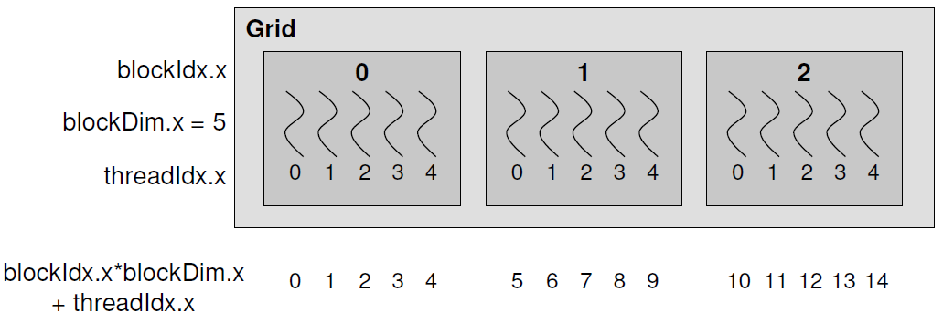
vectorAdd<<<B,T>>>(dev_a,dev_b,dev_c);
__global__ void vectorAdd(int *a,int *b, int *c)
{
int tid = blockIdx.x * blockDim.x + threadIdx.x;
if(tid < N){
c[tid] = a[tid]+b[tid];
}
}

Slide 48
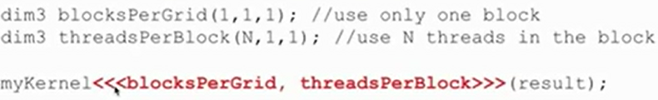
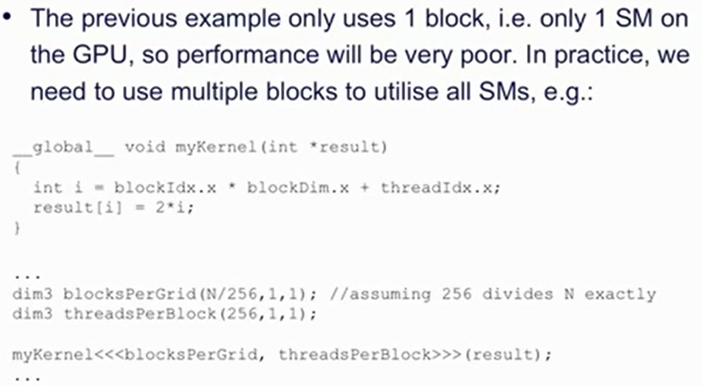

Slide 49
__global__ void add_matrix( float* a, float *b, float *c, int N )
{
int i = blockIdx.x * blockDim.x + threadIdx.x;
int j = blockIdx.y * blockDim.y + threadIdx.y;
int index = i + j*N;
if ( i < N && j < N )
c[index] = a[index] + b[index];
}
Note:
float *a = new float[N*N];
float *b = new float[N*N];
float *c = new float[N*N];
for ( int i = 0; i < N*N; ++i )
{
a[i] = 1.0f;
b[i] = 3.5f;
}

Slide 50
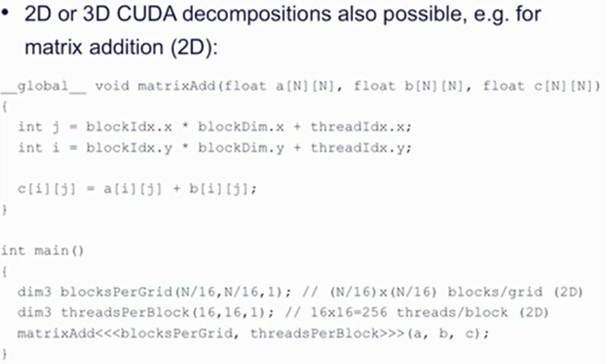

Slide 51
Starting from Q number 1 to Q number n of OpenCL codes that you have written, convert them in to CUDA codes.

Slide 52
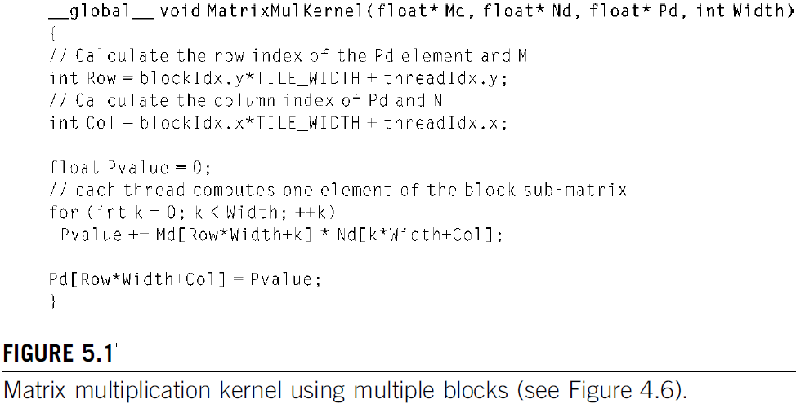
IMPORTANCE OF MEMORY ACCESS EFFICIENCY
We can illustrate the effect of memory access efficiency by calculating the expected performance level of the matrix multiplication kernel code as shown below.

Slide 53
IMPORTANCE OF MEMORY ACCESS EFFICIENCY (Contd..)
The imp part of the kernel in terms of exec time is the for loop, that performs dot product calculations.
In every iter of this loop, two global mem accesses are performed - one floating-pt multi and one floating-pt addition.
Thus, the ratio of floating-point calculation to the global memory access operation is 1 to 1, or 1.0.
Hence, we refer to this ratio as the compute to global memory access (CGMA) ratio, defined as the number of floating point calculations performed for each access to the global memory within a region of a CUDA program.
The CGMA ratio decides the performance of a CUDA kernel.
For eg., NVIDIA G80 supports 86.4 GB/s of global memory access B/W.
The highest achievable floating-pt calculation throughput is limited by the rate at which the data can be loaded from global memory.

Slide 54
IMPORTANCE OF MEMORY ACCESS EFFICIENCY (Contd..)
With 4 bytes in a single precision floating-point data, one can expect to load not more than 21.6 (86.4/4) giga single-precision data per second.
With a CGMA ratio of 1.0, the matrix multiplication kernel will execute at no more than 21.6 billion floating-point operations per second (gigaflops).
CUDA DEVICE MEMORY TYPES
CUDA allows many types of memory which the programmers can use to achieve high CGMA ratios and hence high execution speeds in their kernels.
Below Fig. shows these CUDA device memories.

Slide 55
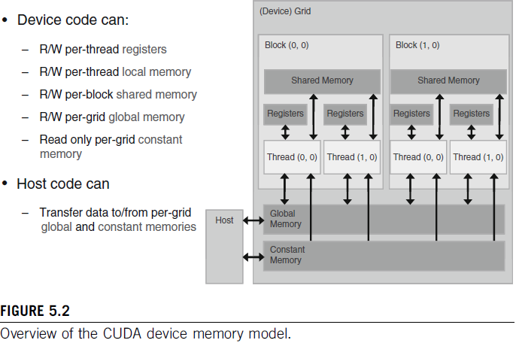
CUDA DEVICE MEMORY TYPES (Contd..)
Global and constant memory can be written (W) and read (R) by the host by calling APIs.
The constant memory supports short-latency, high-BW, read-only access by the device when all threads sim access the same location.
Registers and shared memory are on-chip memories.
Variables that reside in these types of memory can be accessed at very high speed in a highly Ilel manner.

Slide 56
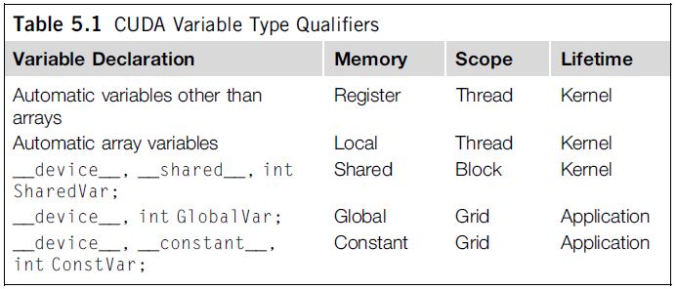
CUDA DEVICE MEMORY TYPES (Contd..)
Registers are allocated to individual threads; each thread can only access its own registers.
A kernel function typically uses registers to hold frequently accessed variables that are private to each thread.
Shared memory is allocated to thread blocks; all threads in a block can access variables in the shared memory locations.
Shared memory is an efficient means for threads to cooperate by sharing their input data and the intermediate results of their work.
By declaring a CUDA variable in one of the CUDA memory types, a CUDA programmer dictates the visibility and access speed of the variable.

Slide 57
CUDA DEVICE MEMORY TYPES (Contd..)
Table presents the CUDA syntax for declaring program variables into the various types of device memory.
Each such declaration also gives CUDA variable a scope and lifetime.
Scope identifies the range of threads that can access the variable: by a single thread only, by all threads of a block, or by all threads of grid.
Lifetime specifies the portion of the program’s execution duration when the variable is available for use: either within a kernel’s invocation or throughout the entire application.

Slide 58
CUDA DEVICE MEMORY TYPES (Contd..)
The scope of these arrays is, like automatic scalar variables, limited to individual threads.
If a variable declaration is preceded by the keyword _ _shared_ _, it declares a shared variable in CUDA.
One can also add an optional _ _device_ _ in front of _ _shared_ _ in the declaration to achieve the same effect.
Such declarations must reside within a kernel fn or a device function.
The scope of a shared variable is within a thread block; i.e., all threads in a block see the same version of a shared variable.
Shared variable is created for and used by each thread block during kernel execution.
The lifetime of a shared variable is within the duration of the kernel. When a kernel terminates its execution, the contents of its shared variables cease to exist.
Shared variables are an efficient means for threads within a block to collaborate with each other.
Accessing shared memory is extremely fast and highly parallel.

Slide 59
CUDA DEVICE MEMORY TYPES (Contd..)
CUDA programmers often use shared memory to hold the portion of global memory data that are heavily used in an execution
phase of the kernel.
One may need to adjust the algorithms used.

Slide 60
CUDA DEVICE MEMORY TYPES (Contd..)
If a variable declaration is preceded by the keyword _ _constant_ _, it declares a constant variable in CUDA.
One can also add an optional _ _device_ _ in front of _ _constant_ _ to achieve the same effect.
Declaration of constant variables must be outside any function body.
The scope of a constant variable is all grids, meaning that all threads in all grids see the same version of a constant variable.
The lifetime of a constant variable is the entire application execution.
With appropriate access patterns, accessing constant memory is extremely fast and all the threads can access in parallel.
Currently, the total size of constant variables in an application is limited at 64 Kbytes.

Slide 61
CUDA DEVICE MEMORY TYPES (Contd..)
A variable whose declaration is preceded only by the keyword _ _device_ _ is a global variable and will be placed in global memory.
Accesses to a global variable are slow; however, global variables are visible to all threads of all kernels.
Their contents also persist through the entire execution.
Hence, global variables can be used as a means for threads to collaborate across blocks.
Global variables are often used to pass information from one kernel invocation to another kernel invocation.
..

Slide 62
Write a Convolution Kernel in CUDA for Convolution algorithm.

